Slide 1
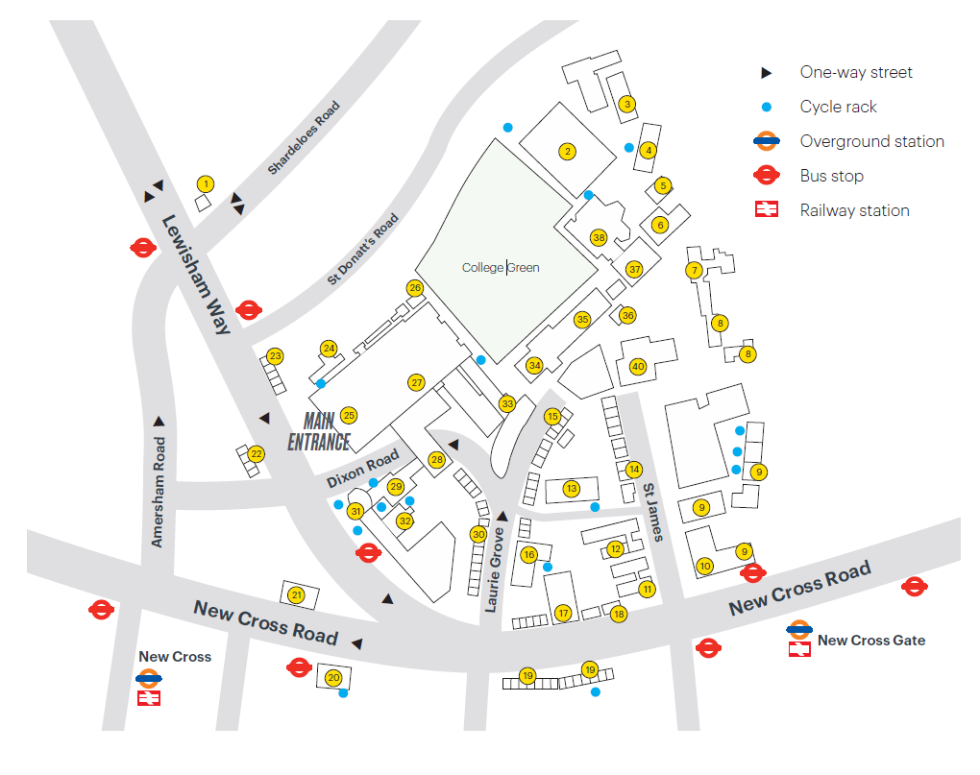
The Map App

Slide 2
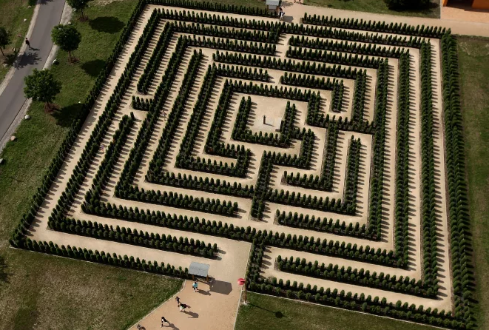
The Motivation

Slide 3
Aims & Objectives
To create a user friendly android application
To include an offline pathfinder
To include a search feature to locate buildings and rooms

Slide 4
Design
An Intuitive and user friendly application
Intended for offline use
Created with accessibility in mind

Slide 5
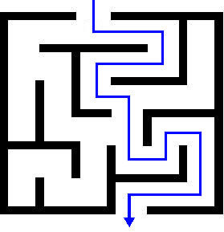
Research
Used to get feedback on current design
Used to verify target audience
Will update the design based on results

Slide 6

Development
Gantt Chart
Milestones
Group Meetings
Github

Slide 7
Outcomes to date
Selected the A* path finding algorithm
Created Node maps of each buildings
Designed Prototype
Currently halfway through the milestones

Slide 8
Future Plans

Slide 9
Addendum Build

